Slide 1



SPLUNK
ADMINISTRATION & SIEM
Prerequisites
Basics Of Linux command
SIEM concepts

Slide 2


DISCUSSION POINTS
What is SIEM?
Role of a Splunk Admin Splunk Architecture Splunk Forwarders Data Onboarding
Data Manipulation Deployment Server Splunk Conf Files License Management Application Management Splunk User and Roles
Splunk Search Fundamentals

Slide 3
DISCUSSION POINTS
Creating Reports & Alert and Visualizations
Working with Dashboards
Lookups
ES Introduction
Getting Started with ES
Tuning Correlation Searches
Creating Correlation Searches
Security Monitoring and Incident Investigation

Slide 4

SIEM
Security Information and Event Management
Security Information and Event Management (SIEM) is a set of tools and services offering a holistic view of an organization's information security.
SIEM Tools Provide:
Real-time visibility across an organization's information security systems. Event log management that consolidates data from numerous sources.

Slide 5
ROLE OF A SPLUNK ADMIN
The Splunk Administrator is responsible for scaling platform deployments, securing Splunk Enterprise, troubleshooting and documenting.
The Splunk Administrator will manage indexes, indexers, and clusters of indexers. The configuration of data from external sources and the enhancement of data an important skills.
The Splunk Administrator must understand how to install and upgrade Splunk Enterprise.
After initial configuration, a Splunk Administrator will need to perform backups, define alerts and manage search jobs.

Slide 6

Splunk Components
Universal Forwarder heavy Forwarder Indexer
Search Head License Master Deploymnet Server
Types Of Splunk Environment
Standalone Deployment Distributed Depolyment Cluetered Deployment
SPLUNK ARCHITECTURE

Slide 7
SPLUNK FORWARDERS
Splunk Forwarder is the component which you have to use for collecting the logs. Suppose, you want to collect logs from a remote machine, then you can accomplish that by using Splunk’s remote forwarders which are independent of the main Splunk instance.
Universal Forwarders
Heavy Forwarders
UF is a lightweight instance of Splunk. Uf just forwarders the data from one end to another end.
HF is a heavy weight instance of Splunk. HF not just forwards the data also filters and parse the data.

Slide 8
DATA ONBOARDING
What Splunk Can Ingest?
Aggregated/API Data Sources Local File Monitoring
Event Logs, Active Directory, OS Stats Unix, Linux and Windows host Wire Data - Splunk Stream
DevOps, IoT, Containers - HTTP Event Collector (Agentless) & many more

Slide 9
DATA ONBOARDING
Important things to keep an eye while data onboarding
Host
Source
Source Type
Index
Data Timestamp
Event Boundary / LineBreaking

Slide 10

DATA MANIPULATION
For Raw data transformations we use props.conf and transforms.conf to mask, filter, line breaking, routing data to a certain index, deleting raw data as it is being indexed and many more.
1
2
3
Masking
Filetring and Data Routing
Line Breaking
Masking
Data masking is a way to create a fake, but a realistic version of your organizational data. The goal is to protect sensitive data.
Filetring
Discarding the unwanted data.
Data Routing
Route certain specific data to a certain index.
Line Breaking
Line breaking is a parsing technique is been used to break lines to split up events.

Slide 11

SPLUNK CONFIGURATION FILES
Most of Splunk's configuration information is stored in .conf files. These files are located under your Splunk installation directory (usually referred to in the documentation as $SPLUNK_HOME) under /etc/system.
Configuration files are stored in
Default files (Do not edit these preconfigured files.): $SPLUNK_HOME/etc/system/default Editable local files: $SPLUNK_HOME/etc/system/local
App files: $SPLUNK_HOME/etc/apps/

Slide 12
DEPLOYMENT SERVER
A deployment server is a Splunk Enterprise instance that acts as a centralized configuration manager for any number of other instances, called "deployment clients".
Used to distributing configurations, apps, and content updates to groups of Splunk Enterprise instances.
Key Elements
Deployment
Server Deploymnet
Client Deployment
App Server Class
Any full Splunk Enterprise instance - even one indexing data locally - can act as a deployment server.
A deployment client is a Splunk instance remotely configured by a deployment server.
A deployment app is a set of content maintained on the deployment server and deployed as a unit to clients of a server class.
A server class is a group of deployment clients that share one or more defined characteristics.

Slide 13

Types of Splunk License
Splunk Enterprise licenses
Trial license Dev/ Test license Free license
Splunk License Master
A license master controls one or more license slaves. From the license master, you can define stacks, pools, add licensing capacity, and manage license slaves.
License Violation
A license violation occurs after a series of license warnings. License warnings occur when you exceed the maximum daily indexing volume allowed for your license.
LICENSE MANAGMENT
Splunk Licensing
Splunk software licenses specify the features you have access to and how much data can be indexed.

Slide 14
APPLICATION MANAGEMNET
Apps are designed to analyze and display knowledge around a specific data source or data set in Splunk.
Application Overview
An app contains one or more views. An app can include various knowledge objects such as reports, lookups, scripted inputs, and modular inputs.
Application Dependencies
An app sometimes depends on one or more add-ons for specific functionality.
Examples
Examples of apps are the Splunk Enterprise Search app and the Splunk App for AWS.

Slide 15
SPLUNK USER & ROLES
You can create users with passwords and assign them to roles that you have created. Splunk Enterprise Free does not support user authentication.
Splunk Enterprise supports three types of authentication systems
Native authentication LDAP
Scripted authentication API
Roles
Users are assigned to roles. A role contains a set of capabilities. Capabilities specify what actions are available to roles.
Splunk Enterprise comes with the following predefined roles,
admin power user can_delete

Slide 16
SPLUNK SEARCH FUNDAMENTALS
Understanding the Splunk Search Interface and Navigation

Slide 17
SPLUNK SEARCH FUNDAMENTALS
3 Things to remember while understanding the Splunk Search
Events
Fields
Fields appear in event data as searchable name-value pairings. Fields are the building blocks of Splunk searches, reports, and data models. When you run a search on your event data, Splunk software looks for fields in that data.
When data is indexed, it is divided into individual events. Each event is given a timestamp, host, source, and source type. Often, a single event corresponds to a single line in your inputs, but some inputs (for example, XML logs) have multiline events, and some inputs have multiple events on a single line. When you run a successful search, you get back events.
Timestamp
The Splunk platform uses timestamps to correlate events by time, create the histogram in Splunk Web, and set time ranges for searches.

Slide 18
Logic Operator in Splunk Searches
NOT OR AND
SEARCH FUNDAMENTALS
Splunk Search Command
Searches Fields Table Where Rename Replace

Slide 19
CREATING REPORTS & ALERT AND VISUALIZATIONS
Save a search as a report
We can save a search query as a Report that we would like to run again or share with others. Once the report is made you can view the result set in the report viewing page.
Edit reports
Once the report is made, if any additional changes are required, you can edit the report. While editing the report, you can schedule the report (Which we call as scheduled report), add many Trigger Actions (eg: Output Results to lookup, Send email, Webhook etc.), change the permission of the report etc.

Slide 20
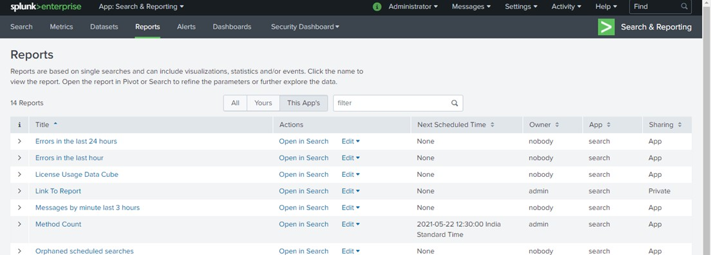
REPORTS
Splunk reports are results saved from a search action which can show statistics and visualizations of events

Slide 21
REPORTS
Create reports that include visualizations such as charts and tables
While creating the report, you can select any visualization, which is suitable for you requirement.
Add reports to a dashboard
The reports, which are not scheduled can be added to any Dashboard as well, just by clicking on the "Add to Dashboard" option on Report viewing Page.

Slide 22
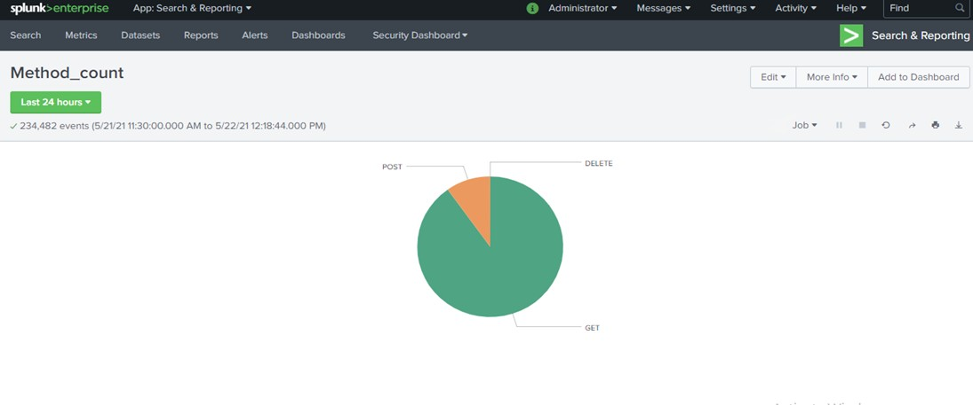
REPORT WITH VISUALIZATION

Slide 23
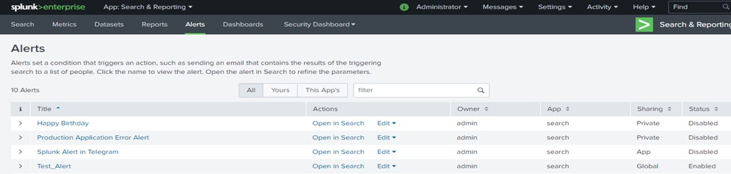
ALERTS
Create Alert
We can save a search query as a Alert that we would like to run on a regular schedule.
Schedule Alerts
We can configure scheduling, trigger conditions, and throttling to customize the alert and also add some Trigger actions like(eg: Add to Triggered Alerts, Send email, Webhook).
NOTE: Any one of the Trigger action is mandatory to create an alert.

Slide 24

Creating a dashboard
Dashboards are collections of views i.e. collection of panels. The panels contain results form search query in visualizations like charts, tables, and lists etc.
WORKING WITH DASHBOARDS
Add a reports to a dashboard
Like we already have discussed once a report is created, we can add it to a new or existing dashboard.
Edit a dashboard
There is also a Dashboard Editor available which you can use to create and edit dashboards. After creating the dashboard, you can perform actions like, using custom visualizations, changing permission etc.

Slide 25
LOOKUPS
Lookup Table
Lookups is used to enrich our event data by adding field-value combinations from lookup tables. Splunk uses lookups to match field-value combinations between event data and external lookup tables. If Splunk finds those field-value combinations in the lookup table, Splunk will append the corresponding field-value combinations from the table to the events in our search.
There are four types of lookups: CSV lookups, External lookups, KV Store lookups, Geospatial lookups. inputlookup command can be used to invoke any lookup file by using the file’s name.
We can use outputlookup command to create or update any lookup file.
We use lookup command to match field-value combinations between event data and external lookup tables.
Lookup Definition
A lookup definition provides a lookup name and path to find the lookup table. Lookup definitions can include extra settings such as matching rules etc. on the fields that the lookup is allowed to match. The Lookup definition can also be used with inputlookup command to see the result of the corresponding lookup file.

Slide 26
LOOKUPS
Automatic Lookup
Automatic lookups is used to apply a lookup to all searches in search time. The advantage of creating an automatic lookup is that we don't need to manually invoke it in searches with the lookup command. We have to use lookup definition to create automatic lookup.

Slide 27
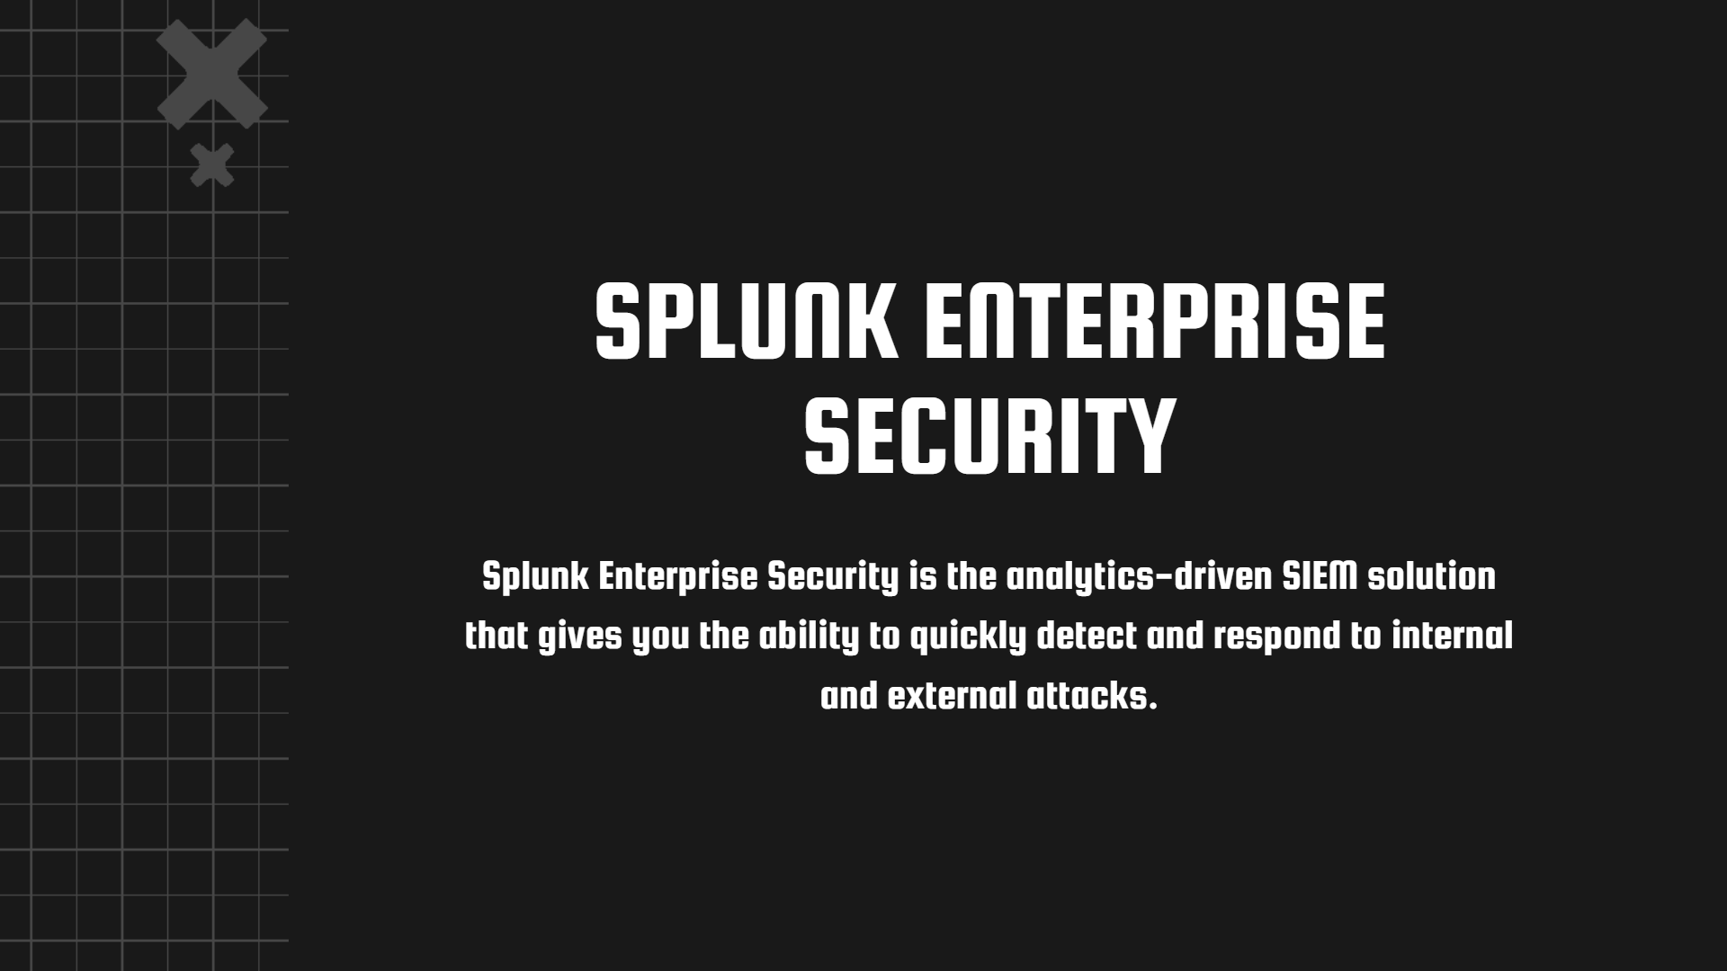


SPLUNK ENTERPRISE SECURITY
Splunk Enterprise Security is the analytics-driven SIEM solution that gives you the ability to quickly detect and respond to internal and external attacks.

Slide 28
ES INTRODUCTION
Splunk developed and introduced a premium Security Information and Event Management (SIEM) solution in the year 2017, named Splunk Enterprise Security, basically a collection of different frameworks which runs on the Splunk Enterprise Core.
Overview of ES features and concepts
Splunk Enterprise Security (Splunk ES) is a security information and event management (SIEM) solution which provides in-built dashboards, reports, correlation searches ( we can built our own correlation searches as well) etc. which helps to quickly detect and respond to internal and external attacks.
CIM model
The Common Information Model is an open standard that defines how elements in an
IT environment are represented as a common set of objects and relationships between them. In Splunk, we can use CIM datamodel.

Slide 29
GETTING STARTED WITH ES
Provide an overview of Splunk for Enterprise Security (ES)
Splunk ES is a SIEM solution that helps security teams to quickly detect and respond to internal and external attacks towards your environment, helps to simplify threat management while minimizing risk, and safeguard your business. Splunk ES uses all data of your environment to gain organization- wide visibility and security intelligence. Regardless of deployment model — on-premises, in a public or private cloud, SaaS, or any combination of these
— Splunk ES can be used for continuous monitoring, incident response, basically running a Security Operations Center (SOC) to safeguard your business. Splunk ES can be deployed as software together with Splunk Enterprise or as a cloud service together with Splunk Cloud.

Slide 30

GETTING STARTED WITH ES
Describe correlation searches, data models and notable events, tstats
Correlation searches are a type of scheduled search that helps us to detect suspicious events and patterns in the data.
We can use CIM data models to create correlation searches.
We can configure a correlation search to generate a notable event when search results meet specific conditions and the notable events populate in the Incident review dashboard of Splunk ES.
tstats command is used to access data from accelerated datamodel. If you see the inbuilt correlation searches in the ES, you can see lots of correlation searches are made with tstats command.
User roles in ES
Splunk ES add the three roles by default. They are ess_user, ess_analyst, admin or sc_admin.

Slide 31
TUNING CORRELATION SEARCHES
Configure correlation search scheduling and sensitivity
We can schedule the correlation searches by adding a cron expression.
Tune ES correlation searches
Correlation searches can generate unwanted notables i.e. false positives, which in results take lot of time for the Analyst to investigate, and we may overlook the legitimate attack. So, tuning the correlation searches is important to reduce false positive.

Slide 32
CREATING CORRELATION SEARCHES
Create a custom correlation search
Configuring adaptive responses
Search export/import
Splunk ES by default provides many correlation searches, but we can create our own correlation searches and also edit the existing to meet our requirement.
Adaptive Response actions allow us to gather information or take other action in response to the results of a correlation search or the details of a notable event.
ES by default include some adaptive response actions like, Create a notable event, Modify a risk score with a risk modifier, Send an email etc.
We can export content from Splunk Enterprise Security as an app from the Content Management page.

Slide 33
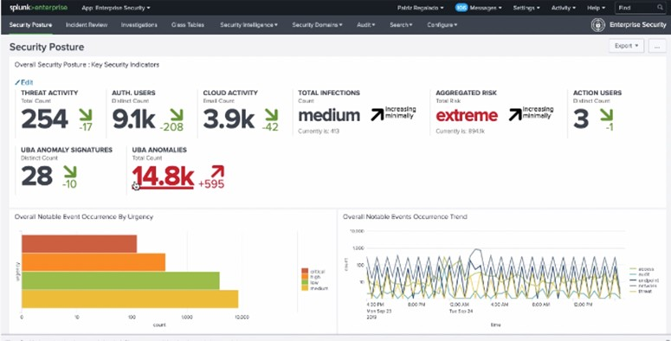
SECURITY MONITORING AND INCIDENT INVESTIGATION
Use the Security Posture dashboard to monitor enterprise security status
The Security Posture dashboard in ES is designed to provide
high-level notable domains
insight events
into the
across all
of your deployment.
This dashboard is very much suitable for displaying in a Security Operations Center (SOC). This dashboard shows all events from the past 24 hours, along with the trends over the past 24 hours, and provides real-time event information and updates.

Slide 34
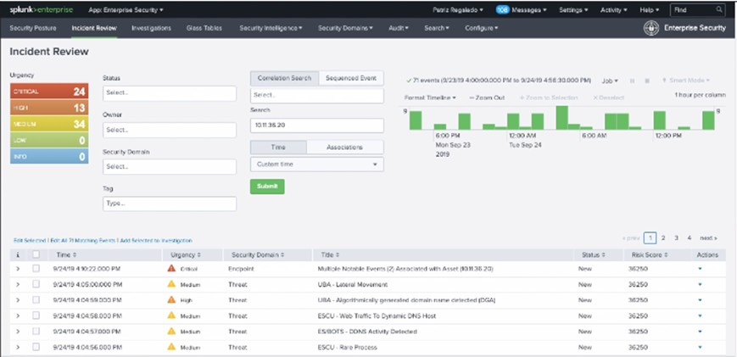
SECURITY MONITORING AND INCIDENT INVESTIGATION
Use the Incident Review dashboard to investigate notable events
The Incident Review dashboard displays notable events and their current status. A notable event can represent one or more anomalous incidents detected by a correlation search across data sources. Security analysts can use the dashboard to gain insight into the severity of events occurring in the system or network.

Slide 35
SECURITY MONITORING AND INCIDENT INVESTIGATION
Take ownership of an incident and move it through the investigation workflow
Use adaptive response actions during incident investigation
After an incident is raised we can take ownership of incident(s) and we can perform investigation on the incident(s). We can perform investigation in many ways like, from Incident Review while triaging notable events , investigation with an event workflow action etc.
While investigating an incident raised in the Incident Review dashboard, we can add adaptive response actions. We can get the option “Run Adaptive Response Actions” by expanding the Actions column of any incident.

Slide 36
SECURITY MONITORING AND INCIDENT INVESTIGATION
Create notable events
Suppress notable events
We can create You can create a notable event from any indexed event using the Event Actions menu.
We can also create a notable event from scratch, based on observations, finding from a security system outside Splunk, or something else by selecting Configure > Incident Management > New Notable Event.
We can hide any notable event(s) from the Incident Review dashboard by suppressing them.
“Suppress Notable Events” option is available under Actions column in any incident in the Incident Review dashboard.

